Slide 1
Visualizing the Los Angeles Metro Bikeshare System
Pratik Bhandari
Prathyusha Butti
Ripan Chowdhury

Slide 2
Table of Contents
Introduction
Abstract
Related Work
Overview
Data Source
Data Abstraction
Task Abstraction
Visualization Design
Design Rationale
Evaluation
Future Work
Conclusion
References

Slide 3
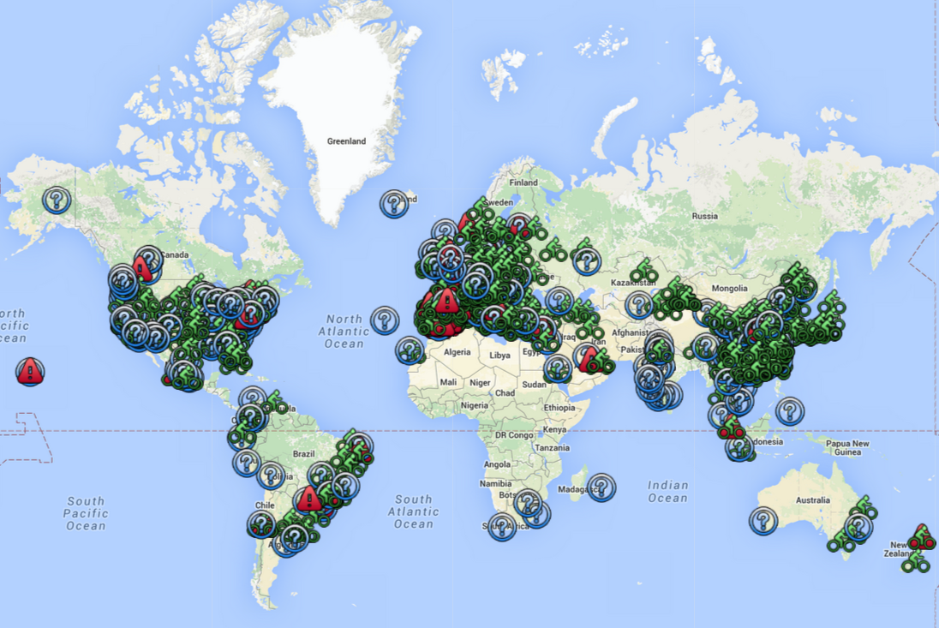
Introduction
Bike sharing programs - system of supplying bikes for hire for point-to-point transportation.
Enables convenient active transportation as people have an option to ride between two stations in a defined geographical area.
The concept of bike sharing systems was introduced in 1965 Amsterdam.
Benefits of bikes in urban areas, where travel distance is short, and the parking prices are high, has caused the demand for bike-sharing systems to increase.
Some of the studies related to this system are descriptive - Mine the data to get a better understanding of the operations.
Information Visualization Schneiderman and Plaisant Ch. 13.jpg
Notes:
Since the introduction of bike-sharing systems, much research has been dedicated to different aspects of these systems.
Figure: Talk about it in the presentation
Locations where bike share systems are being used

Slide 4
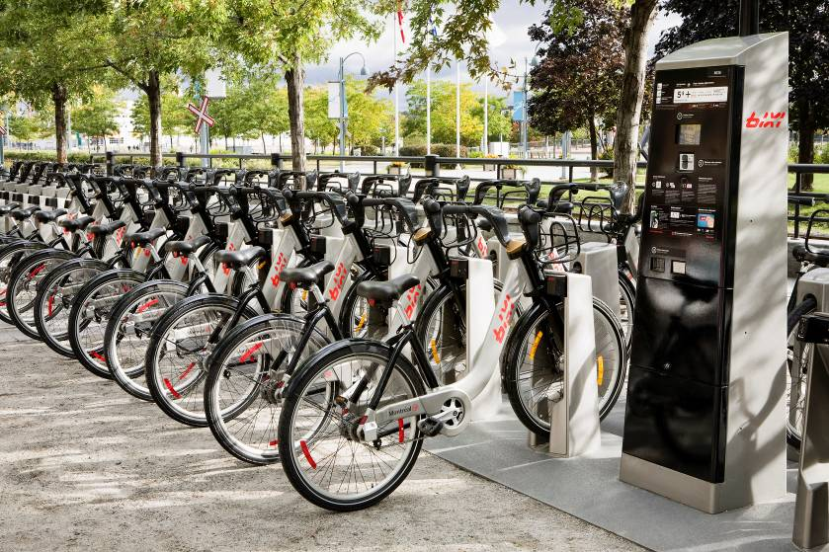
Introduction
Data visualization and analysis of current operations can assist in getting a better grasp of the system.
When data points increases in number, visualization of the data becomes challenging.
But also provides us the opportunity to elucidate in which parts of the city the populous is willing to forego the comfort of motor vehicular transport for shorter commute time and lesser parking fees.
NicoleFreedmanBikeShareJanuary2016.pptx
Notes:
Since the introduction of bike-sharing systems, much research has been dedicated to different aspects of these systems.

Slide 5
Abstract
Bike sharing systems are gaining immense popularity as an alternative or complementary mode of urban transport.
Bike sharing systems may help mitigate automobile congestion and reduce pollution.
In this project, a data visualization approach is used to identify important factors related to the bike-sharing system.
We analyse the bike-sharing system such that we are able to map bike renting trends over the city of Los Angeles and selectively filter through this data on a month-by-month basis over a two year period

Slide 6
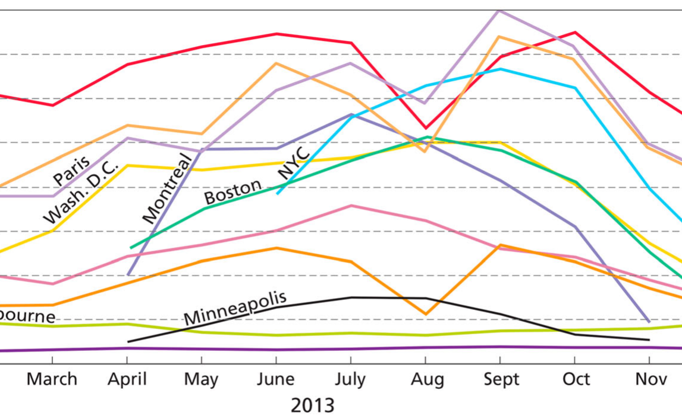
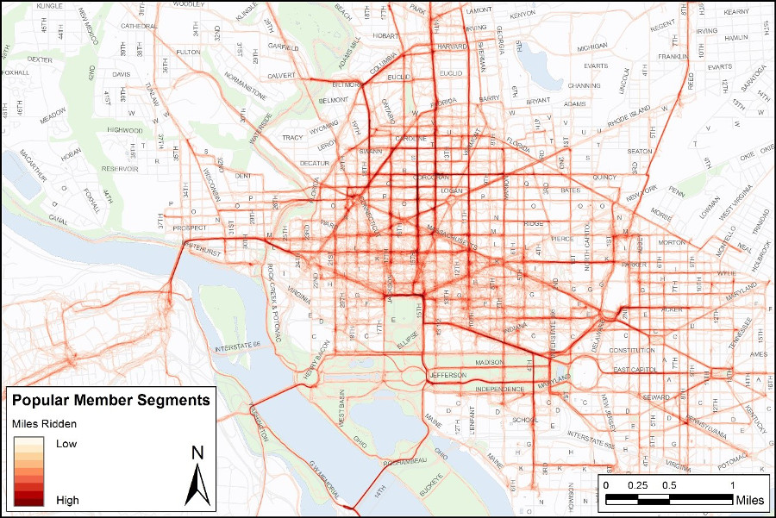
Related Work
Fishman does a more robust study of this system by working on the bike-share data to analyze a considerable number of ideas:
User preference, user frequency, trip purpose, rider demography, and correlation with the health of the rider
A research by DeMaio and Gifford questions if bike-sharing system will be successful in the United States by looking into various aspects such as customer demand, bike facilities, theft and vandalism, profitability and connectivity.
Mobility Lab studied the rider behavior of member riders and casual riders and examined stark differences between their riding patterns.
E. Fishman. Bikeshare: A review of recent literature. Transport Reviews,
36(1):92–113, 2016. doi: 10.1080/01441647.2015.1033036a
https://mobilitylab.org/2016/06/21/capital-bikeshare-gps-data-trips/

Slide 7
Overview
We have mined the Metro Bike Share, Los Angeles data and discussed the findings of this data set
Project goals
Examined the bike-share system during different months/quarters of the year, therefore potentially analysing the sustainability of the bike sharing system
This study also helps in gaining a better understanding of the urban mobility of Los Angeles residents
Our project does not develop a novel visualization, instead uses prevalent methods of visualizing data to try and find trends of a certain behaviour from this dataset
Analyse various types of visualizations, bring together several ideas to form an interactive and easy-to-use interface
Our choice of visualization holds ground with the design practices that make an effective visualization and also takes into consideration some design techniques that further enhance the user experience

Slide 8
Data Source
Initial data source: Kaggle, an online community containing large open-source datasets
Link to data source: https://www.kaggle.com/cityofLA/los-angeles-metro-bike-share-trip-data
Data from Kaggle not enough to build a robust visualization. Had to look for other sources
Current data source: Metro Bike Share, a Los Angeles based bike share company
Released their open source data of two years
More diverse and larger dataset

Slide 9
Data Source
Data Structure
trip id - Unique ID for a particular trip
duration - Duration of the trip in minutes
start time - Start time of the trip
end time - End time of the trip
start lon - Starting position longitude
start lat - Starting position latitude
start station - The station ID where the trip originated
end station - The station ID where the trip terminated
end lat - Destination latitude
end lon - Destination longitude
bike id - Id for each bike
plan duration - Duration of the customer’s plan
passholder type - The name of the pass holder’s plan like ”One Day Pass” or ”Monthly Pass” or ”Walk-up” or ”Flex Pass”
trip route category - ”Round Trip” for trips starting and ending at the same station or ”One Way” for all other trips

Slide 10
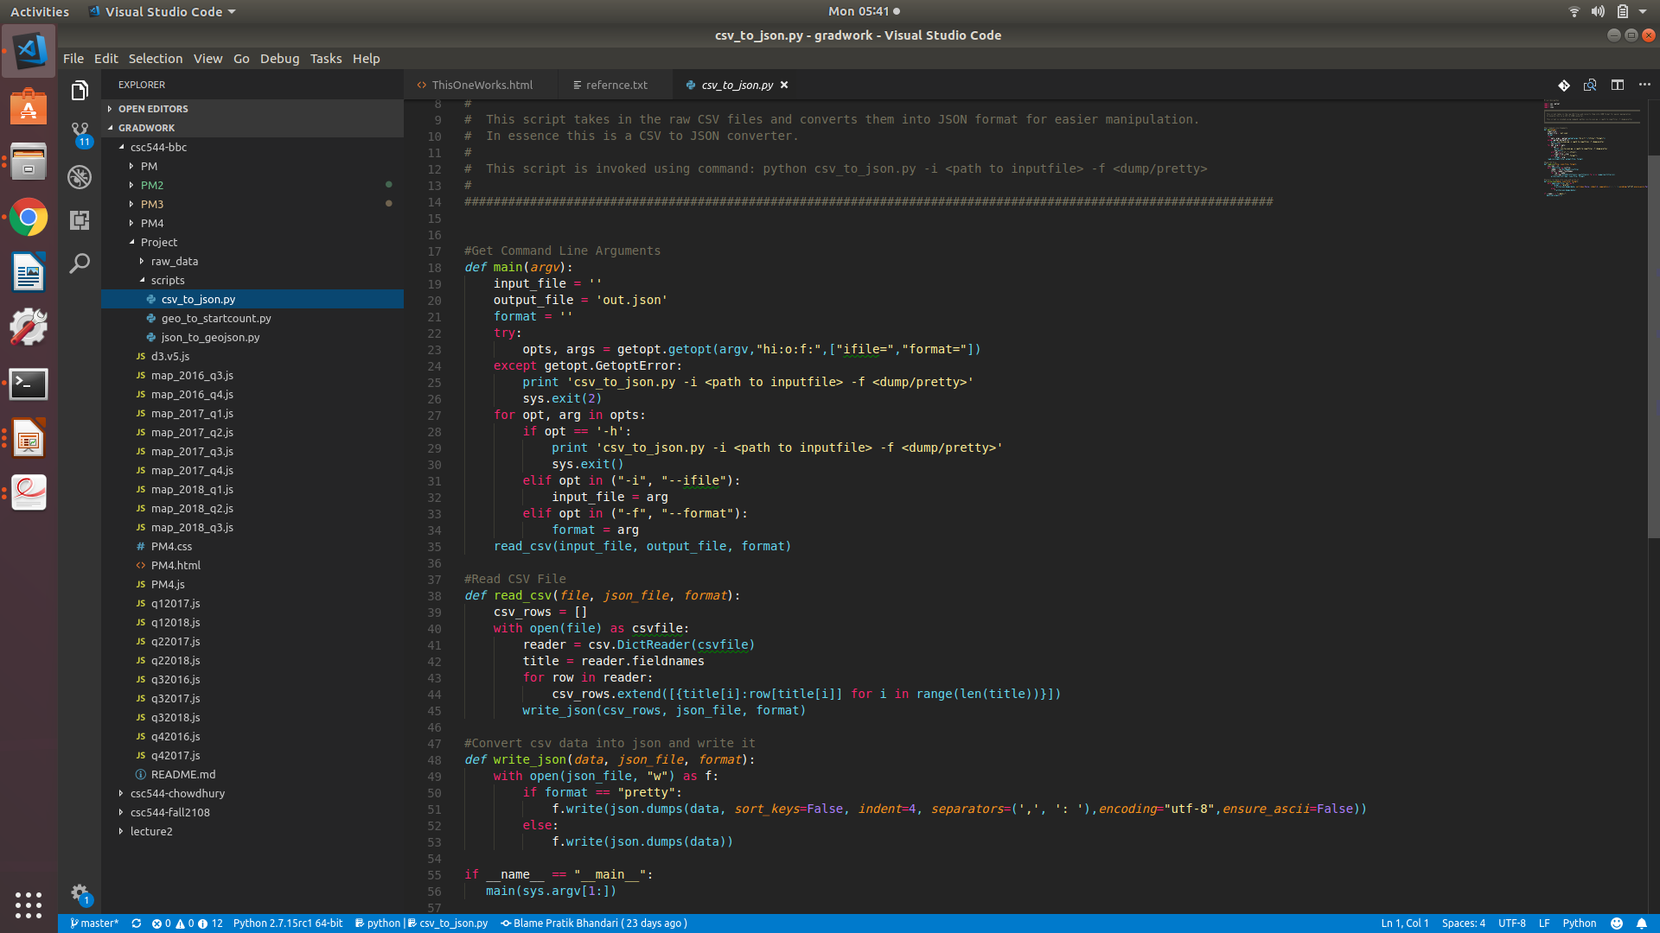
Data Abstraction
Data Collection
Data used for the visualization was collected from the database of Bike Share Metro, a bike share service based in Los Angeles
Data divided into several segments, each one contained the information for a single quarter of a calendar year i.e. Q1, Q2, Q3 or Q4
Data Refinement and Restructuring
The raw data in the CSV format is not suitable for processing and analysis. We used a more standard approach to work with data and for this the CSV data files were converted into JSON (JavaScript Object Notation) format.
All the data cleaning and pre-processing was done using the Python programming language.

Slide 11
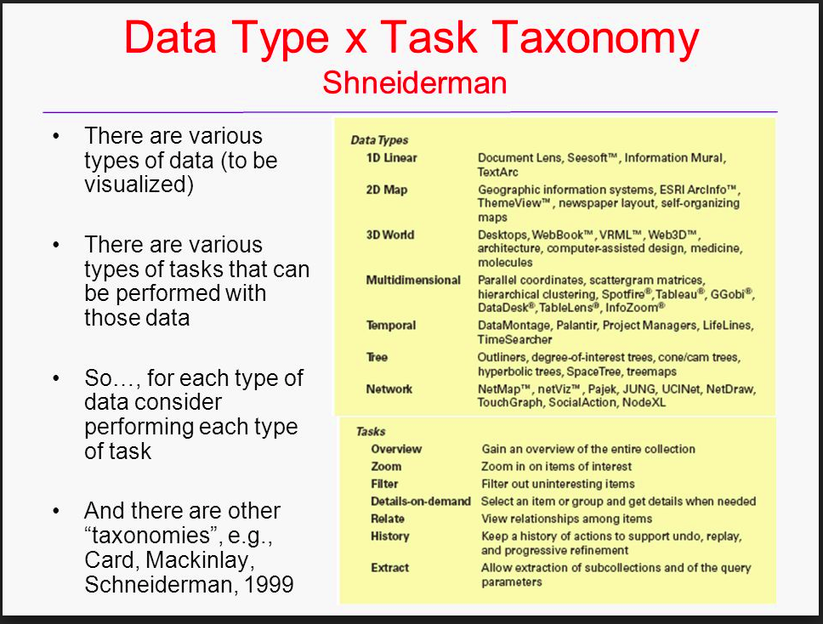
Task Abstraction
Create a design process model for data visualization
Utilized our teams combined experience in visualization design
Concepts from existing models
Applied Schneiderman's task taxonomy to further drill down on the required tasks

Slide 12
Task Abstraction
Goals
G1: Get a mental picture of business according to location:
Helpful in analysing the viability of the bike share system
Around which geographic locations most of the business tend to gather?
G2: How the volume of the rentals changes over time:
Visualize how the number of customers changes over time
Provides us with clarifications about which time of the year people tend to chose this form of transport over others

Slide 13
Task Abstraction
Tasks
T1: Getting the overview of the data:
First, identify all the stations from their longitude and latitude over the city of Los Angeles.
If there is a heavy density of stations in some particular locations, analyse how well individual stations are performing in that heavy cluster
Come to decisions about whether some stations may be relocated in some other location where the density of the stations is relatively low
T2: Filtering Based Geographic Mapping:
Mapped the hires like in the first visualization. The data being represented in the geographic plane is controlled by a click through a time histogram.
Get an analysis of the data from nearly 2.5 years
Gives us a clear insight of the growth/decline of the business model over time

Slide 14
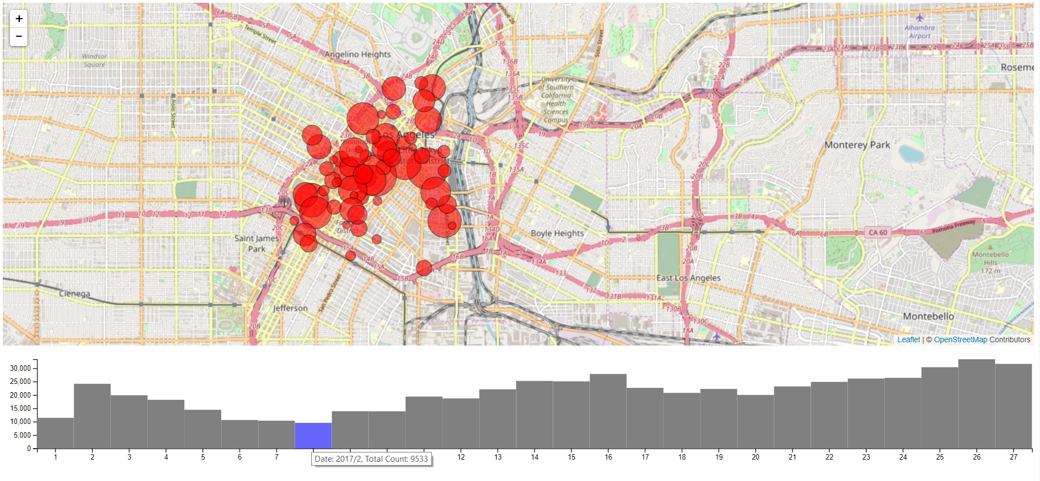
Visualization Design
Two interactive visualizations
Top
Geographic map of Los Angeles
Maps location of each bike station
Points as marks, encoding longitude and latitude value
Area of points encodes frequency of bike rents
Bottom
Time histogram over 2 years
Every bar represents one month
Height is encoded with frequency of bike rents

Slide 15
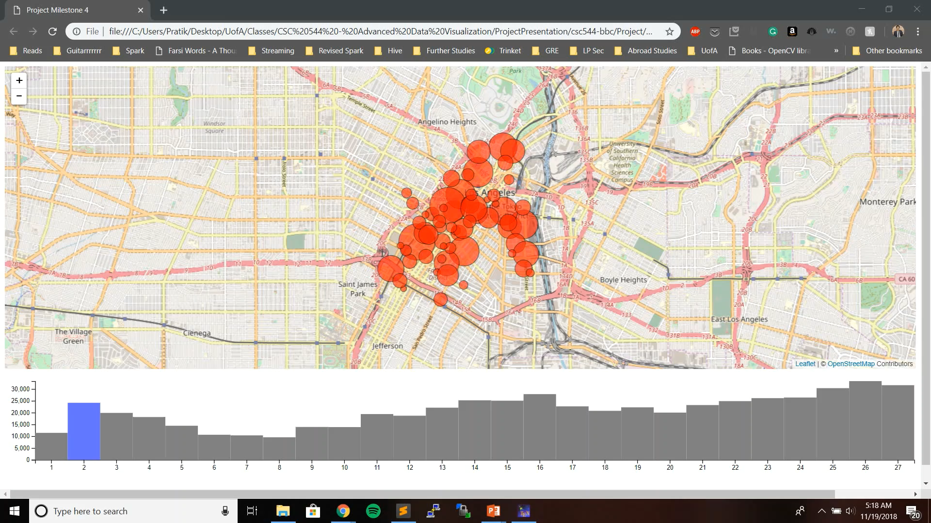
Visualization Design: Interactions
Both data points and histogram bar show tooltips on hover
Basic map navigation
Pan – Right and Left
Zoom – In and Out
Semantic Zooming
Limit to zoom in
Clicking on bars of histogram selects all data from that month and filters data points on the map accordingly

Slide 16
Design Rationale
What design decisions were made?
Why were some designs chosen over the others?
Our decisions relied on answering several questions:
How do you effectively visualize a large amount of data?
What works best for geographical data?
How would it be easier for users to find trends on a high level over time?
Followed an iterative design process and made decisions that were influenced by:
Class lectures
Academic books and slides
Previous related work
Evaluation in between project peers

Slide 17
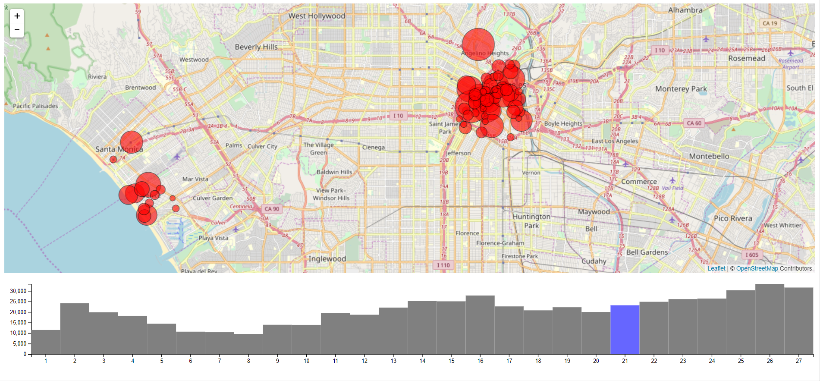
Design Rationale
Geographic Map
Data has geographic aspect to it – contains longitude and latitude values
Location is an important part of the design process
Mapping these stations to their specific locations helped with a high-level context
Supported interactions of zooming and panning helped with focus on individual stations
A zoomed out high-level overview seemed to work best when looking for trends over time
Library used – Leaflet
Choices: Google Maps vs Leaflet

Slide 18
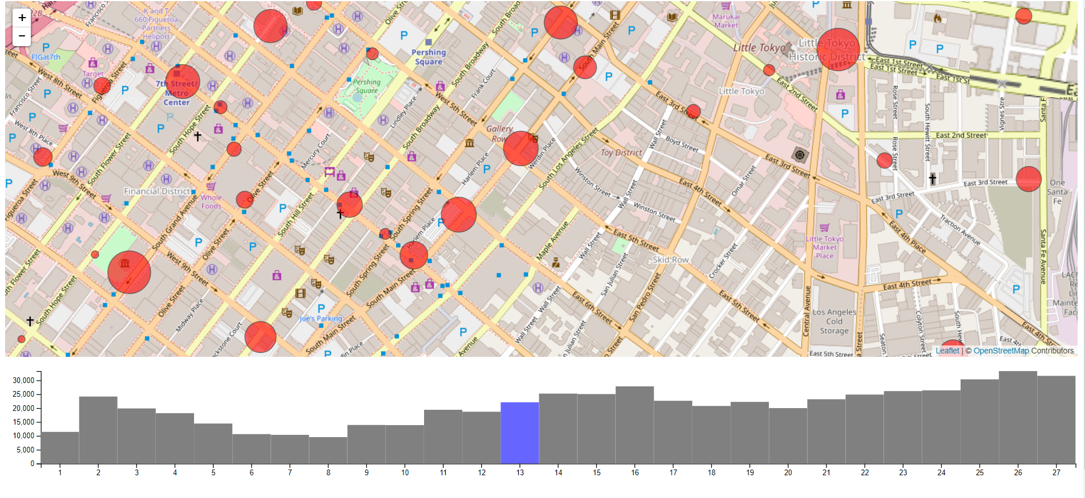
Design Rationale
Marks used – Points and Areas
Marks encode the location of individual bike stations in the map of LA
Areas encode the frequency of bike rents from a particular station
Larger Area: More bike rents
Rationale behind mark selection
Individual data points (bike rent stations) represented using the longitude and latitude – Points as data marks
Circles as data points instead of other shapes (rectangle, triangle, etc)
Area also used as an encoding for bike rent frequency
Varying area of circle by quantity is easier for reference compared to area of rectangle or a triangle

Slide 19
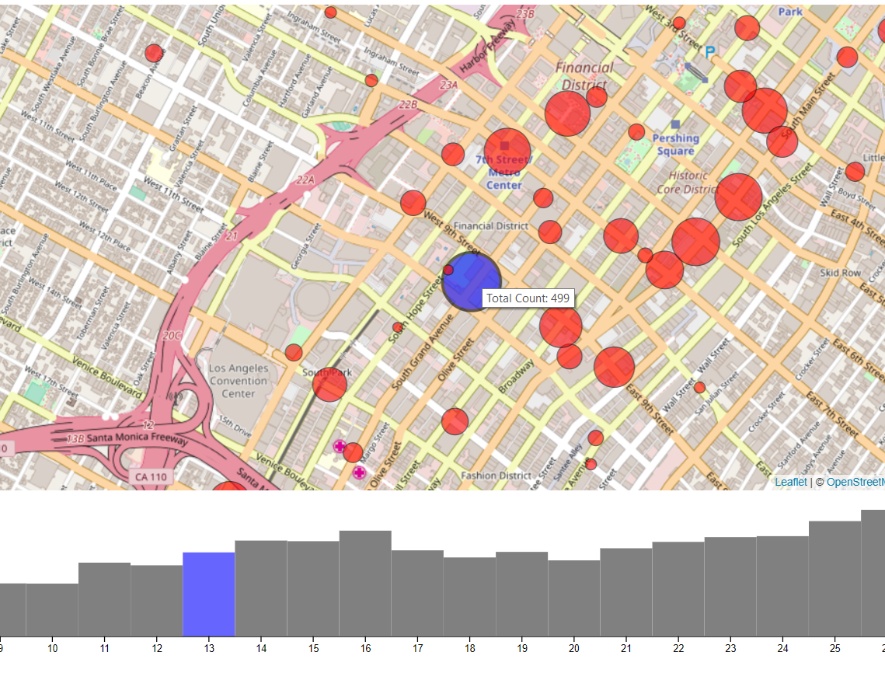
Design Rationale
Color Selection
Red – primary color for data points
Blue – selection color for points and histogram
Picking a proper color that sits on top of a geographic map – tricky
Underlying map contains ‘green’ foliage, ‘blue’ ocean and sea, ‘gray buildings’, etc
Red – non-intrusive with background map and pops out
Blue – Separation between red and blue on a pool of data points is distinct
Lowered opacity on data points to provide some background reference to its location in the map

Slide 20
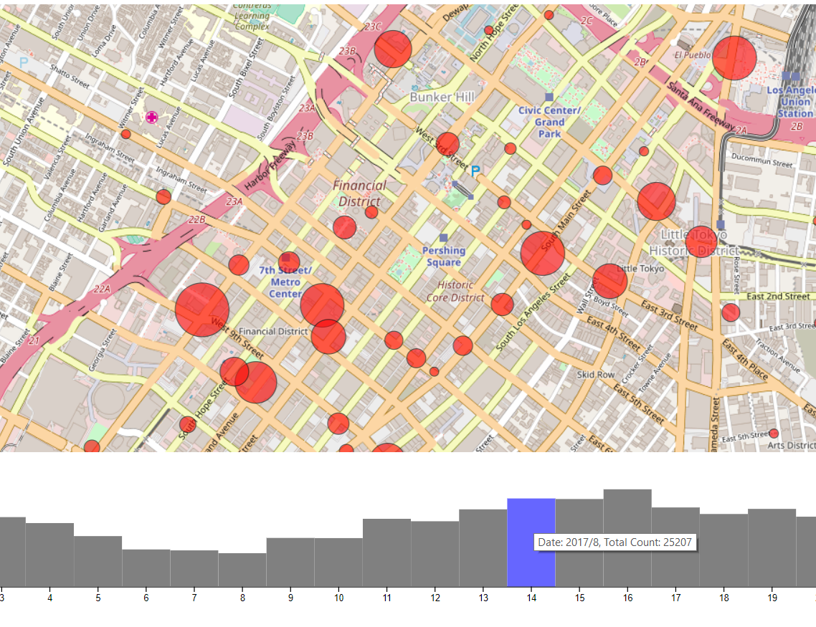
Design Rationale
Data Selection
Hovering over circles – brings up toolkit
Two options – Hovering vs clicking
Initial testing with clicking
As per feedback, found hovering more user friendly
Hovering over histogram bars – toolkit
Data Filtering
Clicking on individual bars of histogram
Selects a particular month
Data on map gets filtered accordingly

Slide 21
Future Work
Moving forward, several additions/enhancements to be done
Complete unmet milestones
Implement a brush filter over the time histogram
Addition of revenue information encoding
Run the visualization over a server with the data being stored in a backend database
Faster
Scalable
Improved data parsing and cleansing
Current raw data to .js array conversion is crude. Makes visualization slower
Modularize, optimize and run it over a single script.
Possible enhancement
Overlay a line graph showing weather information over the histogram for individual months.
Relation between bike rents and weather

Slide 22
Evaluation
In a broad sense, this is an Application Based Visualization Project.
Primary evaluation method: User test surveys: Group of 4-5 people
Two step evaluation process:
User Q&A
Open-ended questions
What can you infer from the visualization at a first glance?
What do you think this visualization is trying to achieve?
Does the visualization look appealing to you when you first see it?
Do you think the visualization fulfill its initial objective?
Close-ended questions
Which area of LA has more bike stations?
How are the bike rents distributed across a certain area of bike stations?
What overall trend can be inferred from the bike rent data?
Is the bike rent system equally distributed around the city? Where is it most popular?
Are there any outliers in the bike share data?

Slide 23
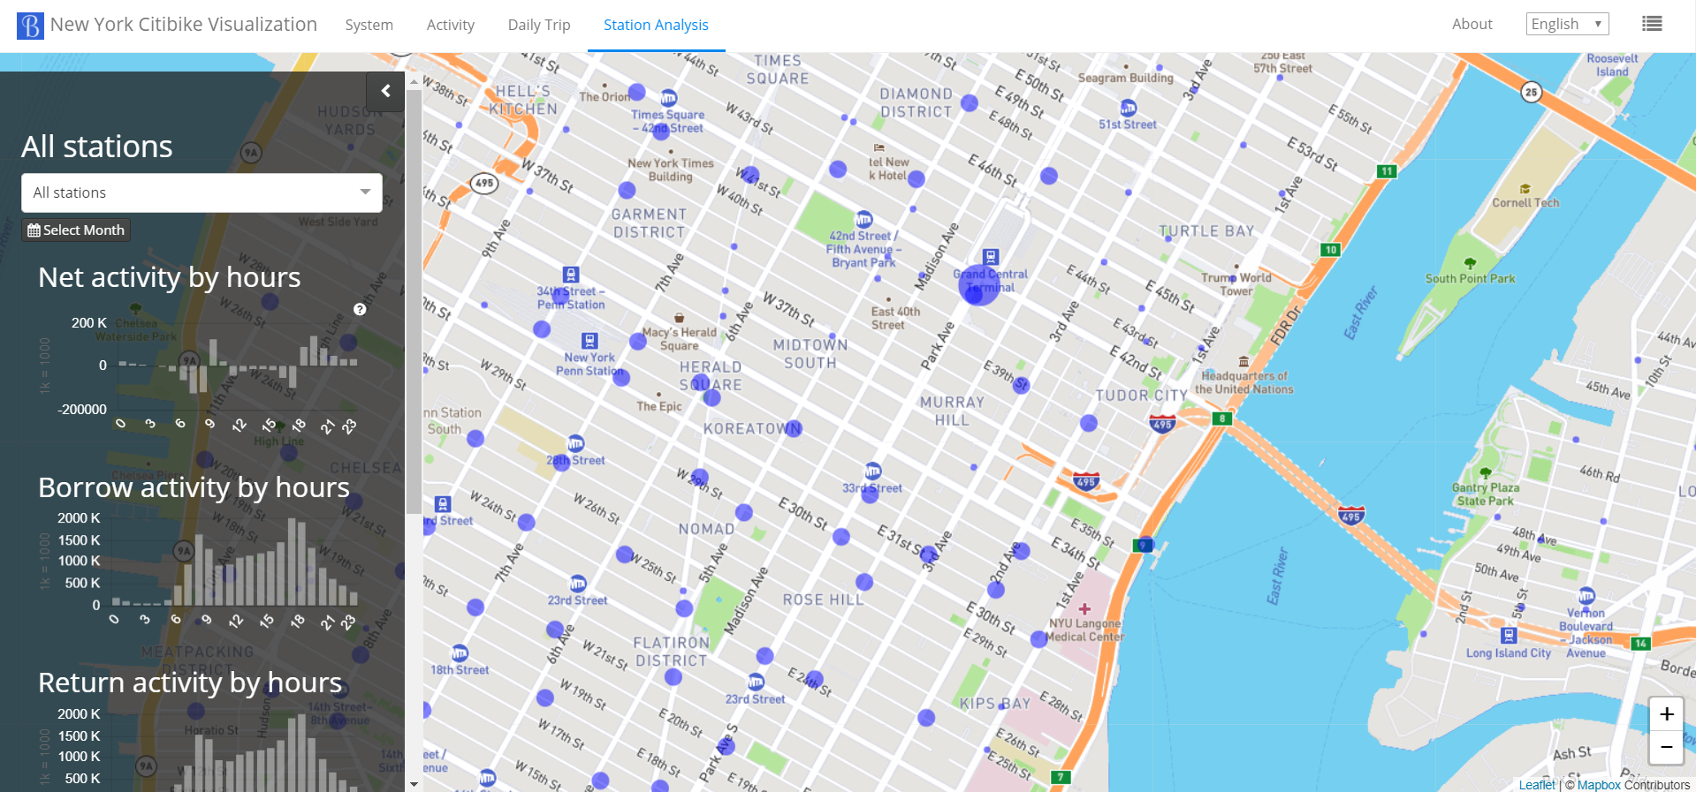
Evaluation
Two step evaluation process:
Visualization Comparison
Provide survey participants with two visualizations
One ours and another similar visualization made by someone else
Ask both sets of open and close ended questions again, focusing more on the close-ended questions
Compare results between two answers
Quantitative analysis also done by measuring time taken to find a specific data point or answer the same questions for both visualizations
Visualization used: New York Citibike Visualization
Closest visualization which matched our objectives
Only a segment of actual visualization used for comparison
Reference: https://www.visualization.bike/citibike/od

Slide 24
Evaluation
Results
User Q&A
Positive feedback on open-ended questions
Overall objective was met by the visualization (5/6 participates answered with affirmative, 83.3% success)
Reaction was mixed towards initial appeal (3/6 answered with positive appeal, 50-55% success)
Time histogram could have been better (as suggested by 2 participants)
Close-ended questions were answered with relative ease
Finding busiest stations and station distribution was done quickly
Trend of bike rents was inferred with ease
Visualization Comparison
New York Citibike had more features and interactions, making it more favored than our visualization (5/6 favored the New York Citibike)
Open-ended questions provided similar results both in terms of answer type and time to answer – the answers being positive on both
Close-ended questions too did not vary much from each other, the New York Citibike resulting in faster answers, primarily because of faster data processing and a smoother filtration process.

Slide 25
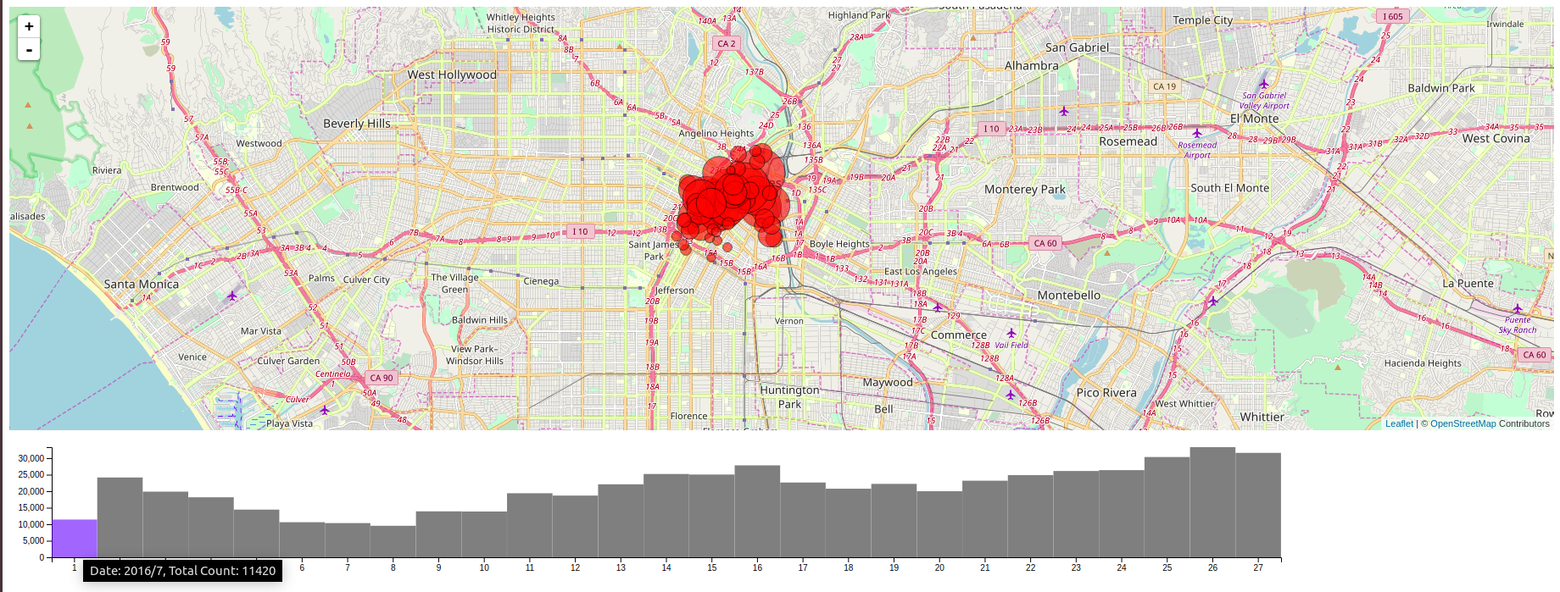
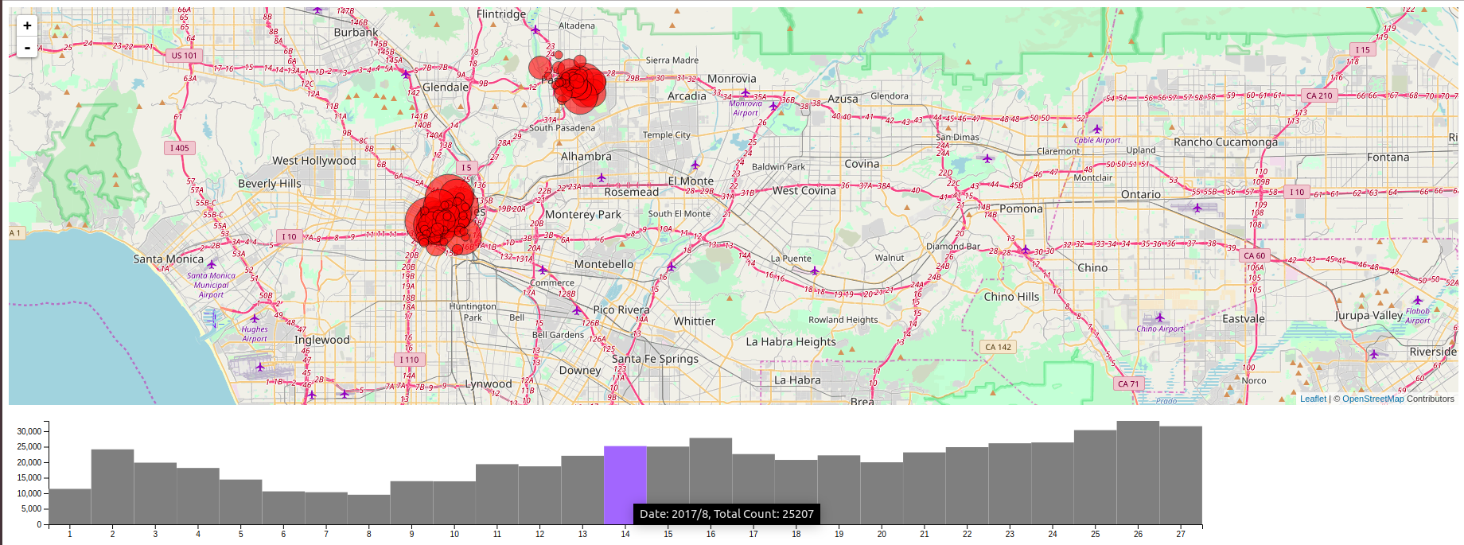
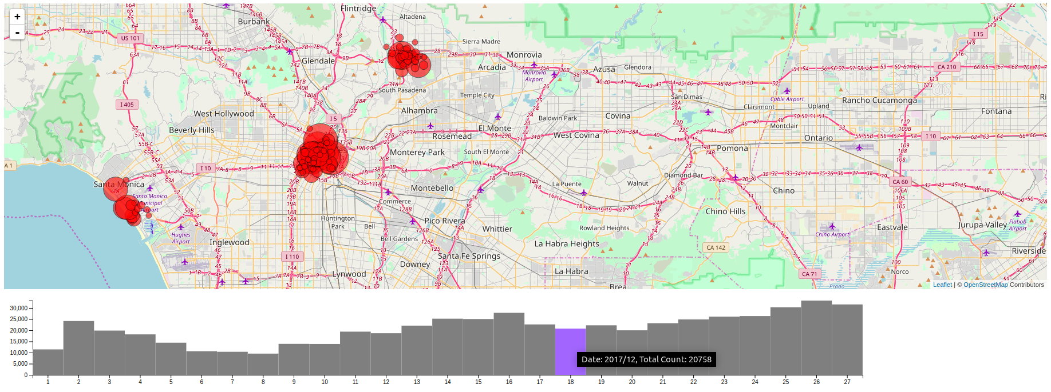
Conclusion
Findings
Though the rentals started from Financial District, over the years the number of rentals increased in other parts of LA.
We can see that a healthy number of rentals also started in Santa Monika in the West and Pasadena to the East.
So we see that this bike sharing model is a growing field with a lot of potential, and it has viability in urban areas with heavy traffic.

Slide 26
Thank You

Slide 27
Questions?

